Slide 1









Y&R
PROJECT
STATUS-PAGE.CASH-GUN.COM

Slide 2
Status-page infrastracture
Project Timeline
1
Learn Status-Page Application
5
CI/CD
2
Design The Architecture
6
Budget
3
Infrastructure As Code
7
Next Sprint
4
Monitoring/Logging

Slide 3
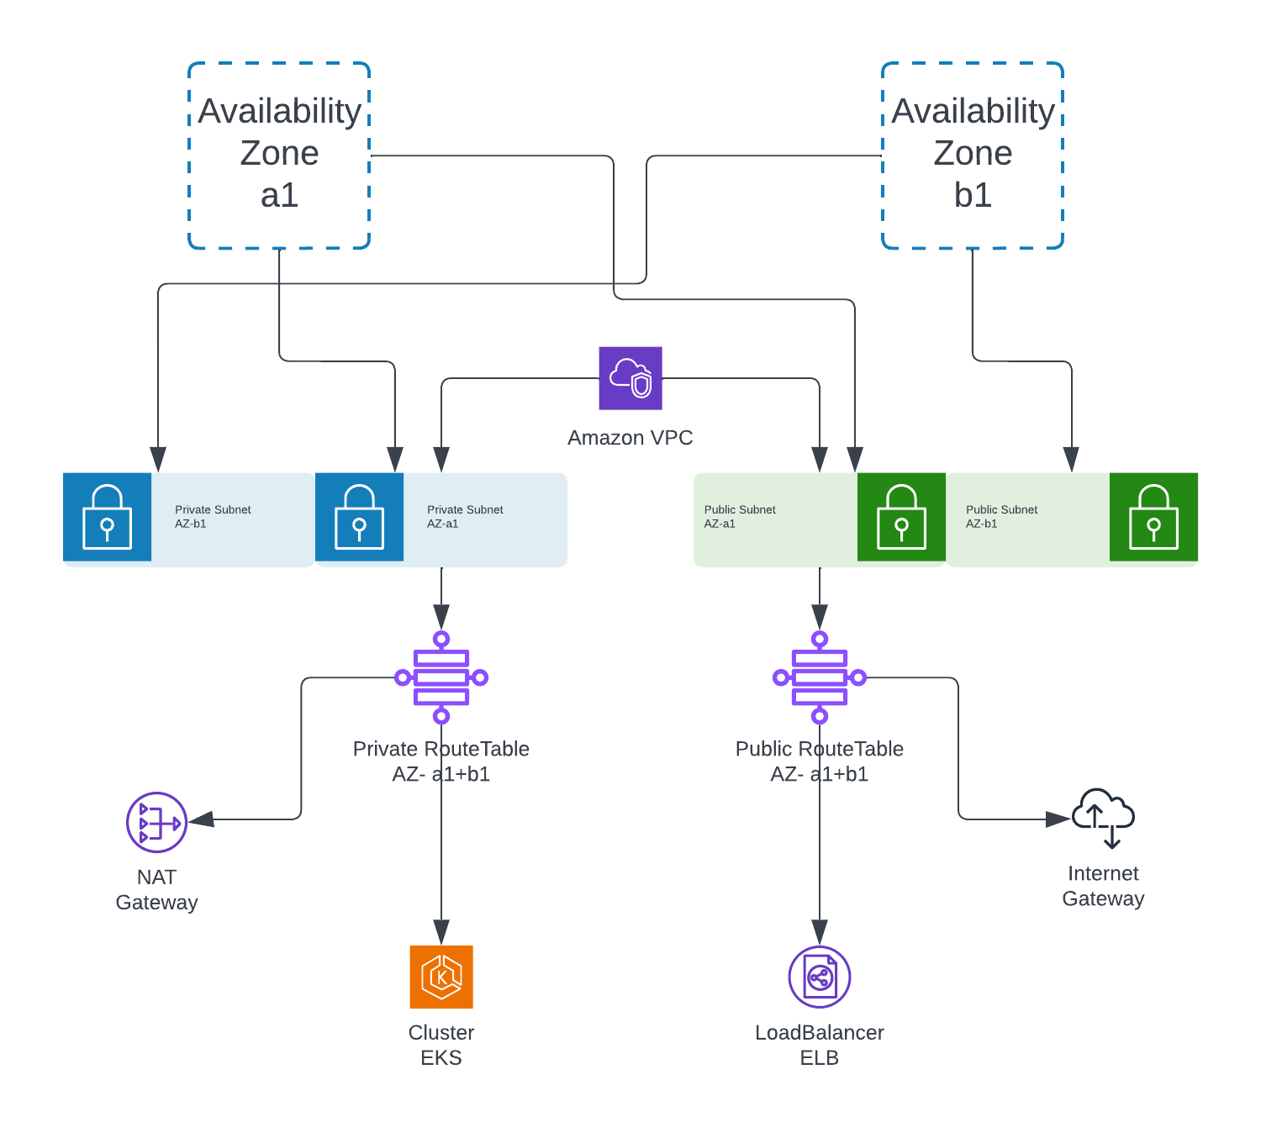

Slide 4
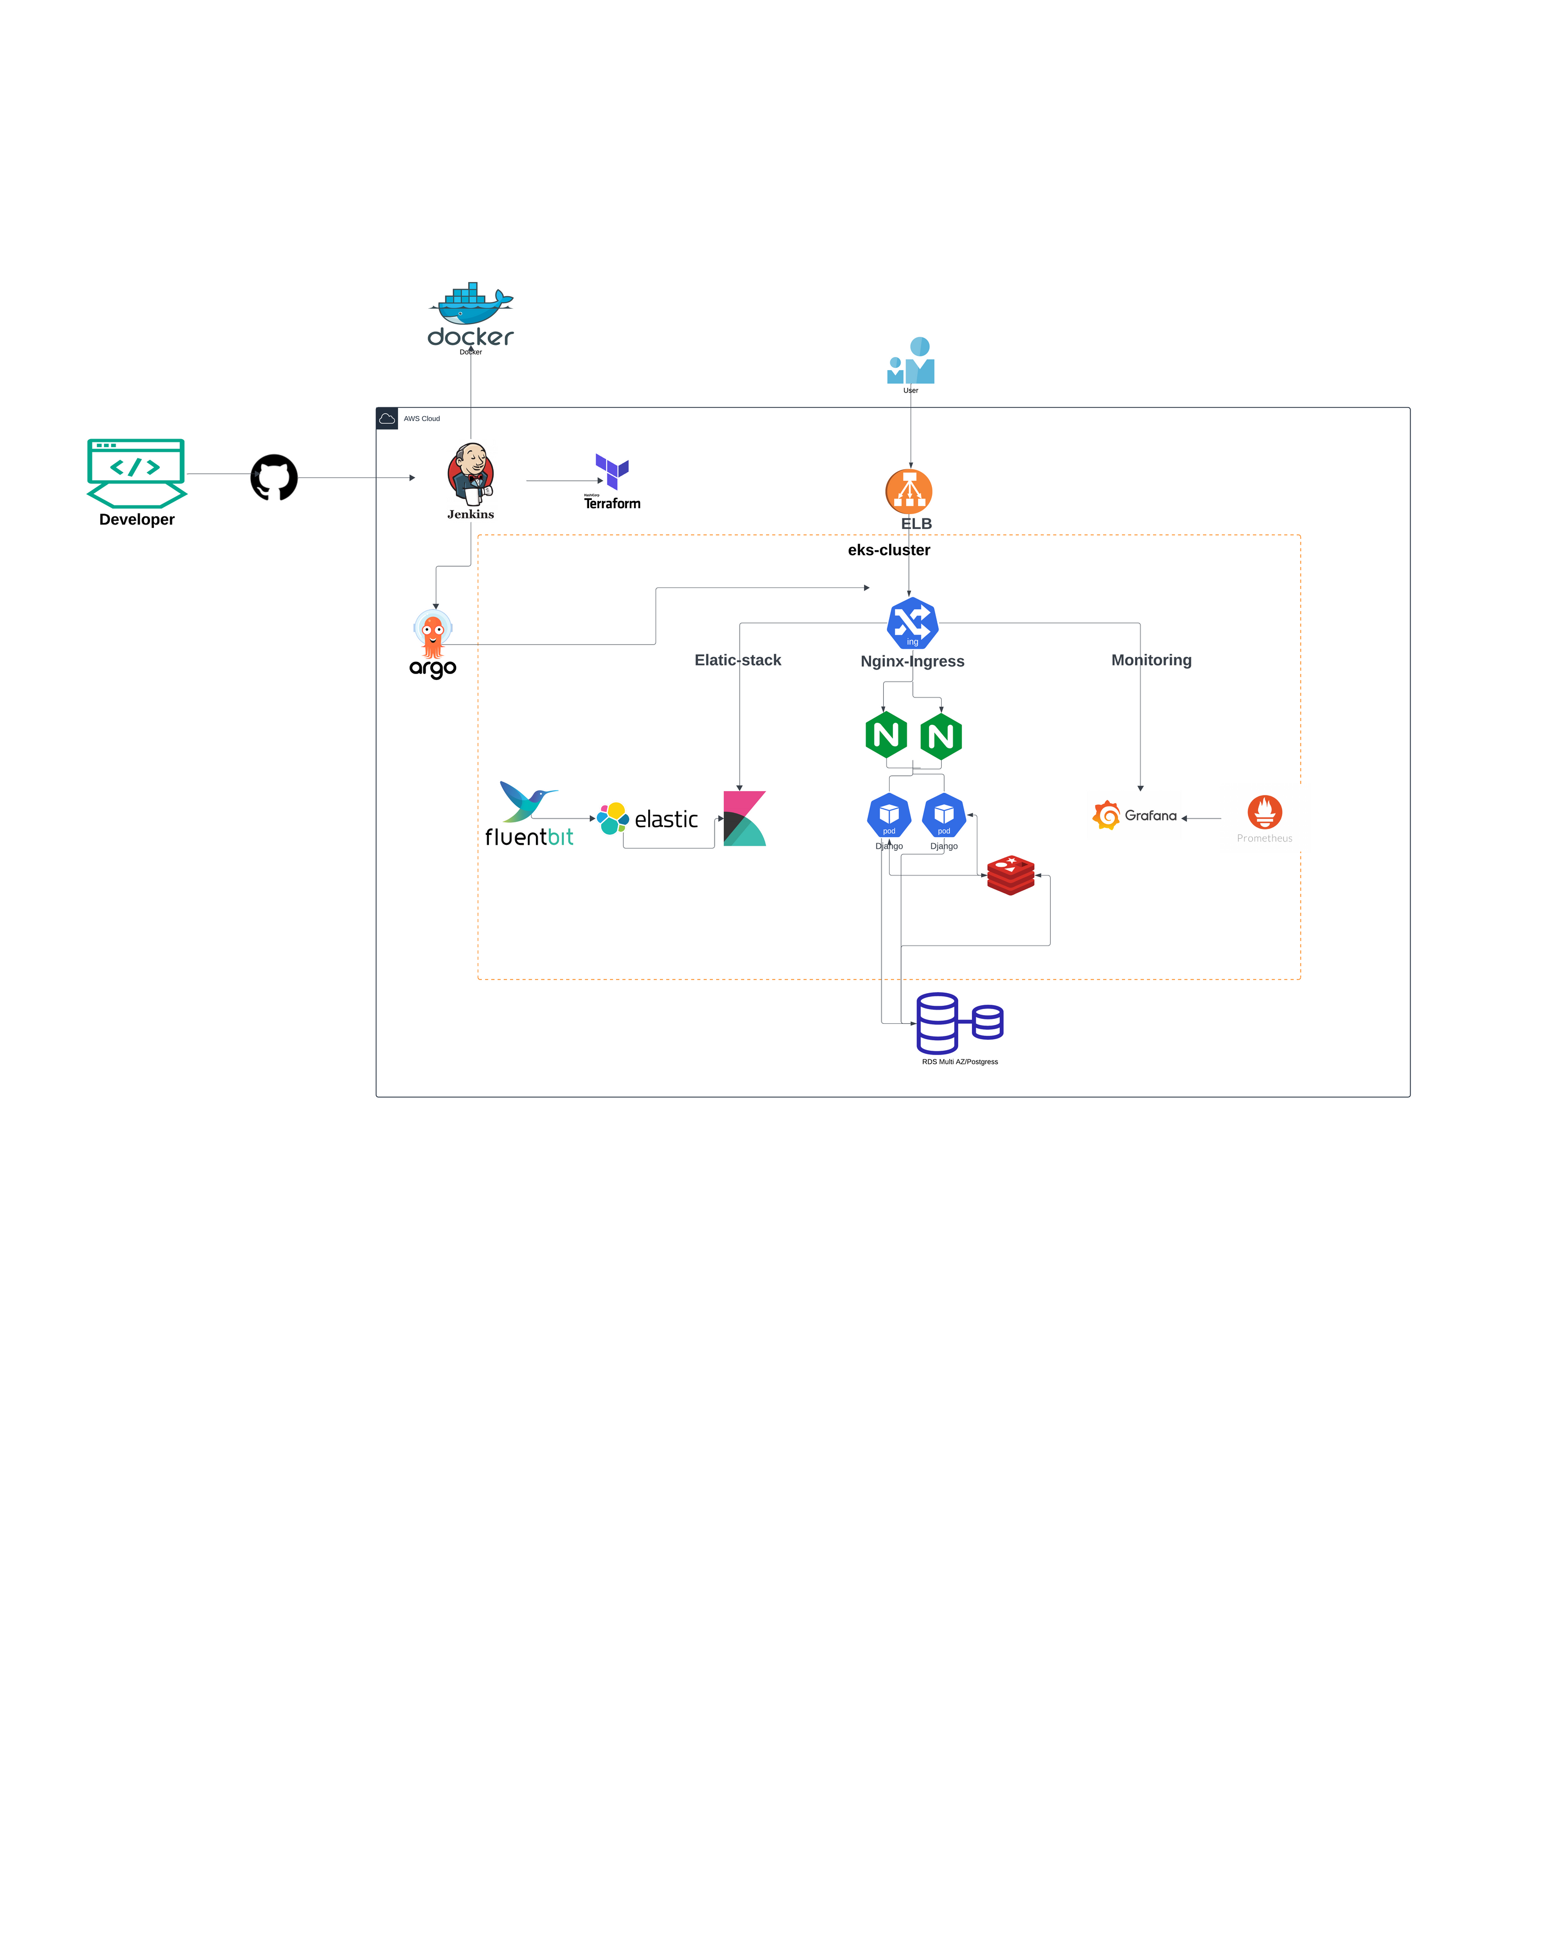

Slide 5
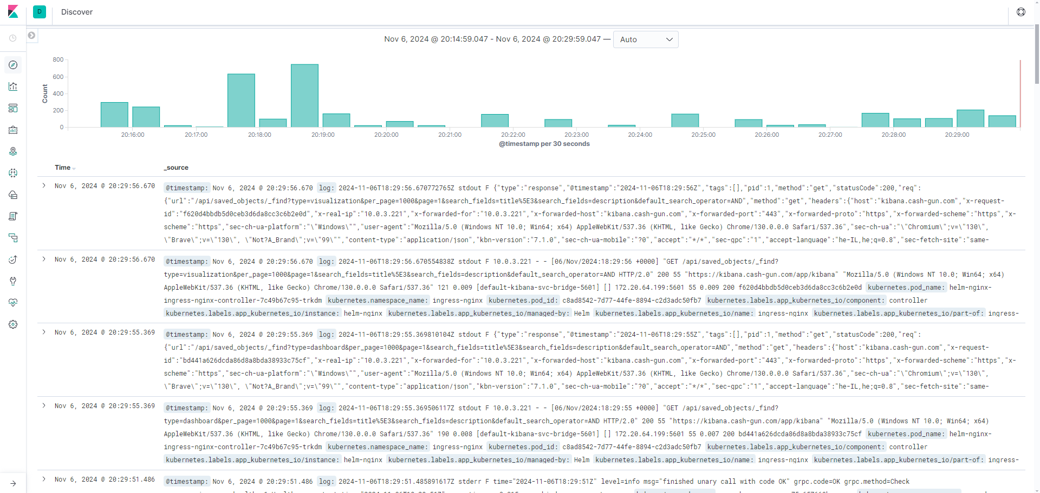

Slide 6
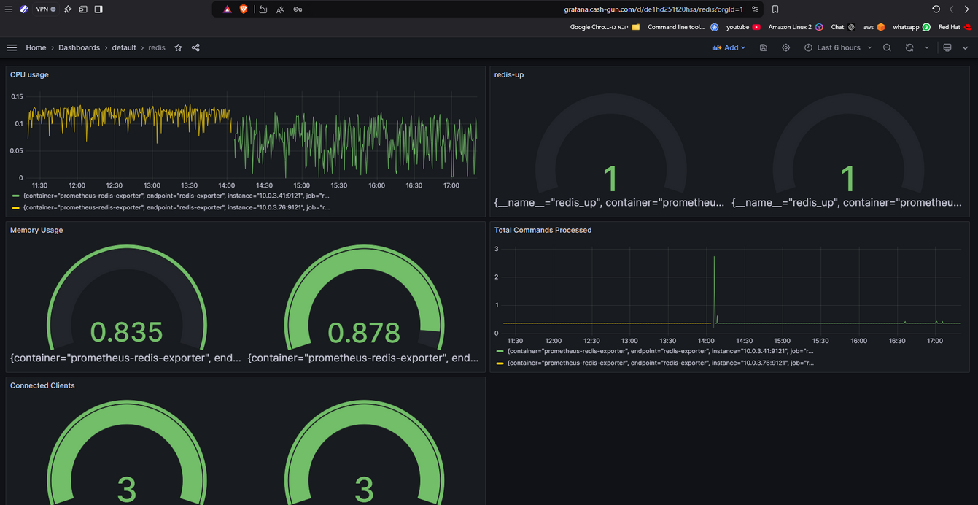
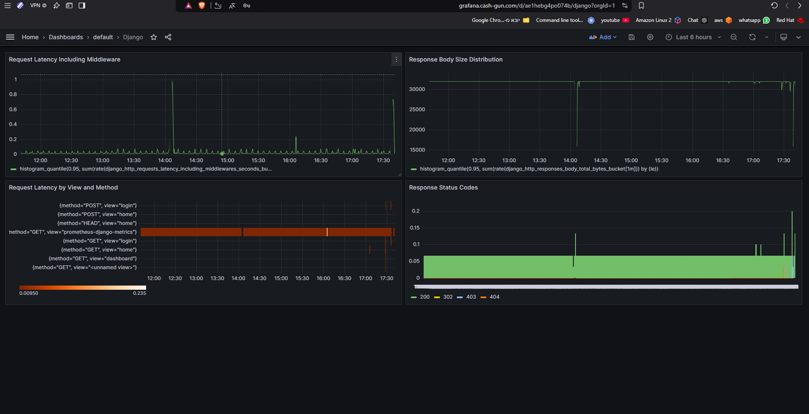

Slide 7
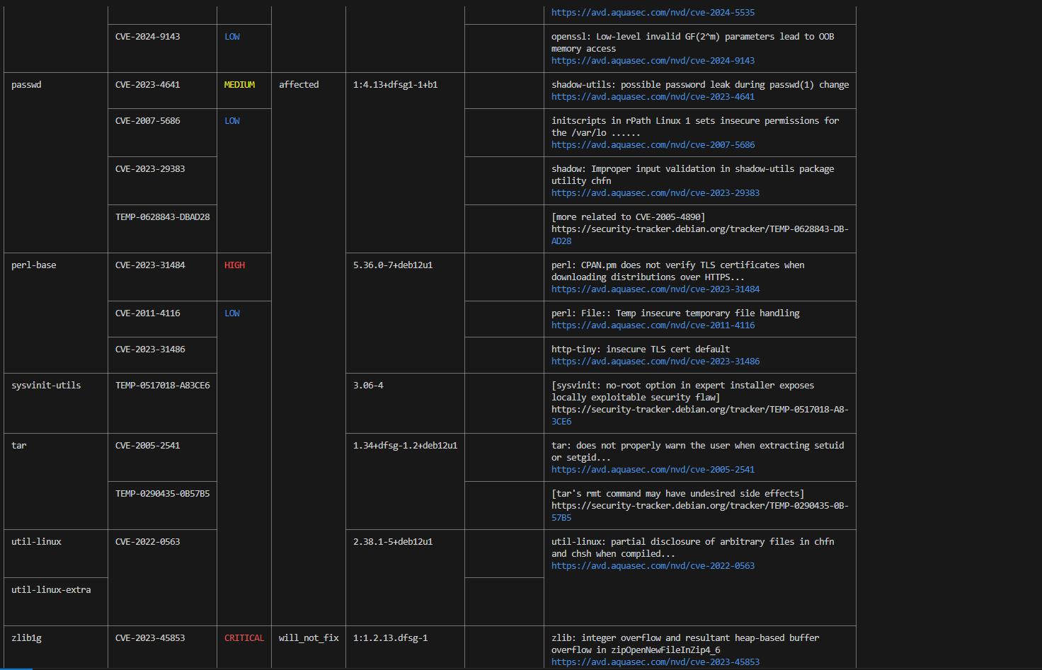

Slide 8
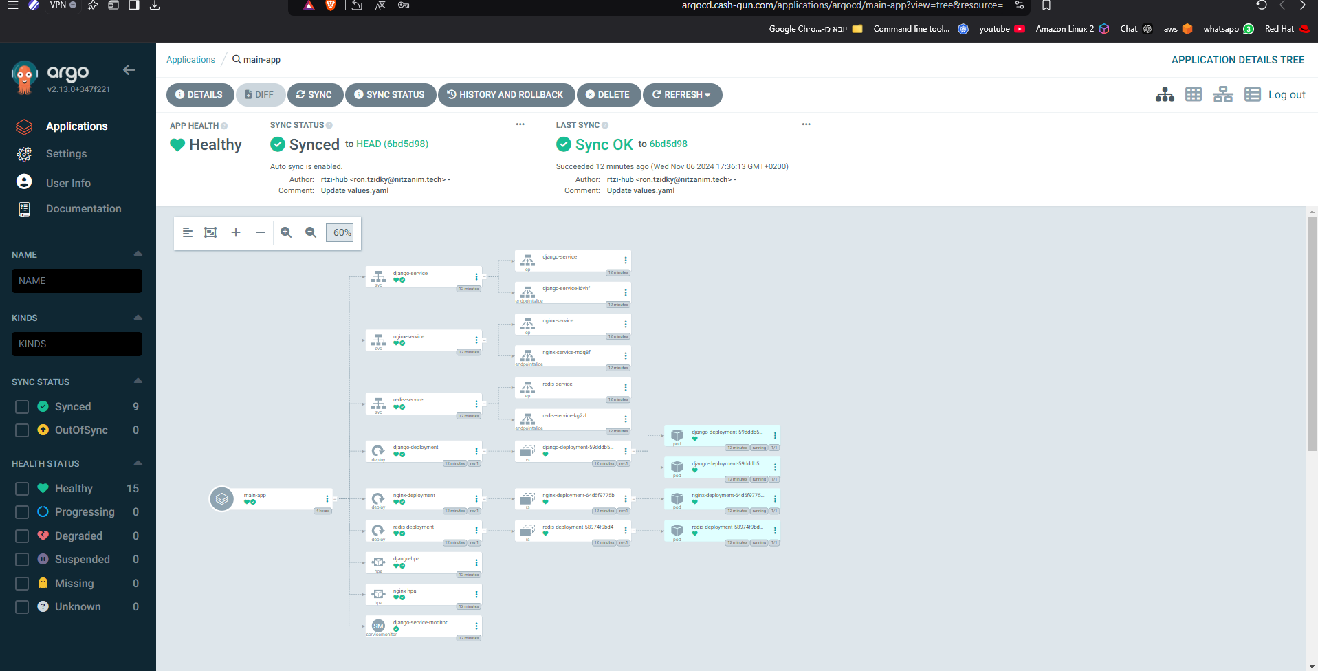
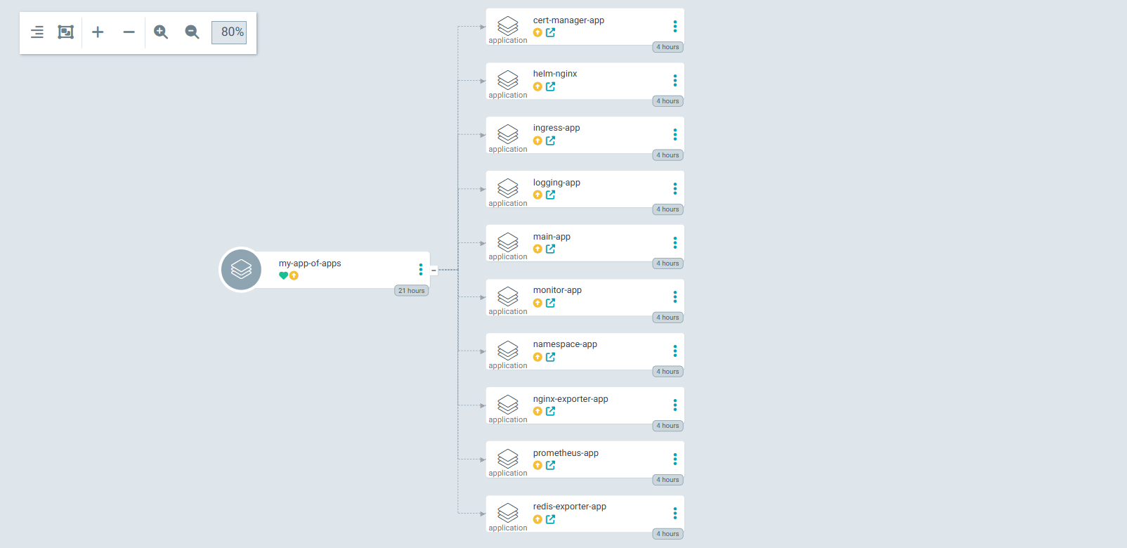

Slide 9
Monthly budget
vpc + NAT = 30$
3 EC2 t2.medium = 67.89$
EKS = 70$
ELB - 100K Requests = 18.5$
RDS t3.micro - 20GB = 16$
total cost = 202.39$

Slide 10


